Slide 1
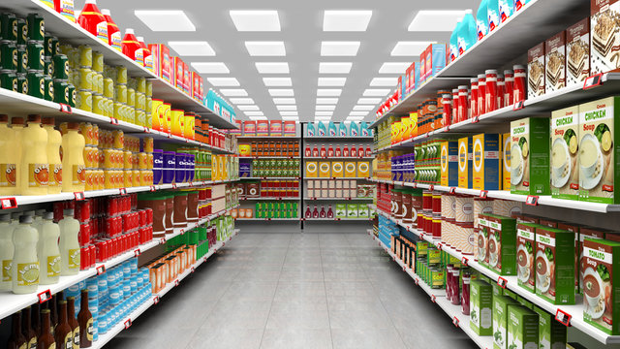
SALES ANALYSIS REPORT
FOR THE STARS SUPERMARKET AS AT JANUARY-MARCH 2019.
Prepared By: Surajudeen Monsurat

Slide 2
Problem Statement
Analyzing sales and customer behaviour allows the management of The Stars supermarket to make strategic decisions which can increase customer shopping experience and lead to overall revenue generation increase.

Slide 3
Analysis Objectives
The objectives of this analysis are as follows.
To determine the overall monthly sales performance across all branches.
To identify high-performing branch and locations.
To compare the quantity of products sold in correlation with the revenue generated.
To identify customers payment preference across different cities.
To analyze the influence of gender demographics on the products purchased across different cities.

Slide 4
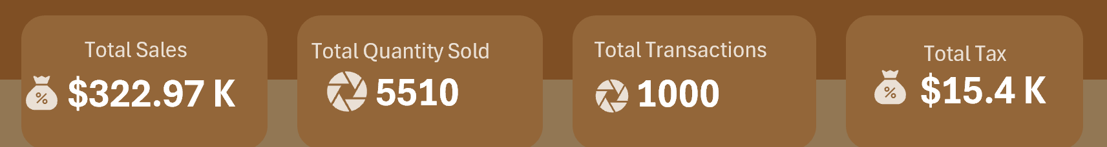
KPIs
The total sales across all branches summed up to $322.97K and a total of 5510 products across different lines were sold in 1000 transactions.
The amount generated for tax in three months on all products totaled to $15.4K

Slide 5
Overall Report
Highest sales was recorded in January which drastically fell in February. However, it rose a little bit in March but wasn’t up to the sales in January.
Naypyitaw recorded the overall highest sales and electronics accessories led in the product quantity sold category. However, food and beverages generated more sales. The customers constitute more of female (50.1%)
In the customers preferred payment method, E-wallet (34.50%) is a little bit above cash (34.40%), while only 31.1% of the customers prefer to use credit card.
The overall average customer shopping experience ratings is 6.97.
Members shopped more in January at Yangyon and Mandalay than in Naypyitaw.

Slide 6
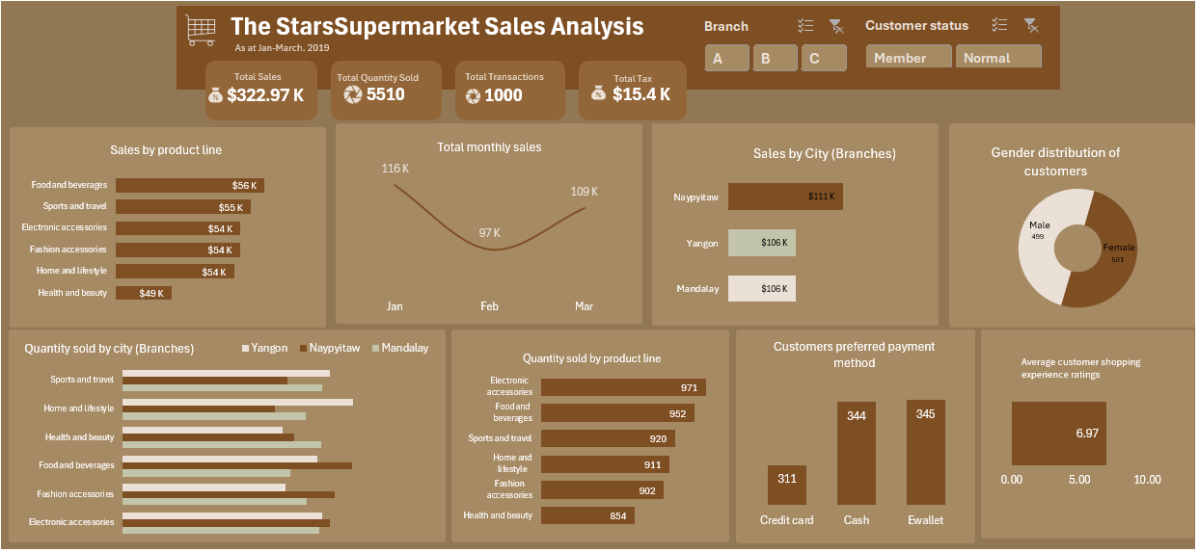
Overall Report

Slide 7
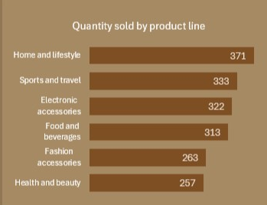
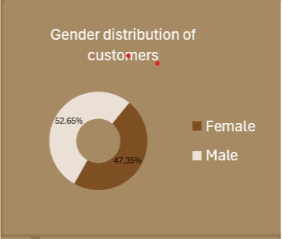
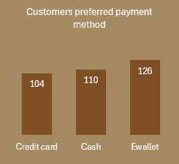
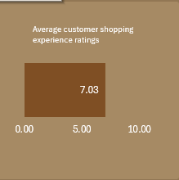
Insights from Yangyon (Branch A)
Home and lifestyle products sold more
Male customers are more than the female.
E-wallet is the most preferred payment method.
Average customer experience ratings.

Slide 8
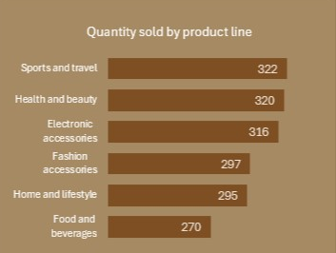
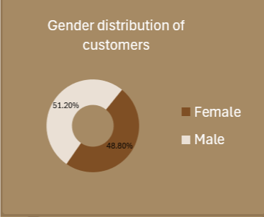
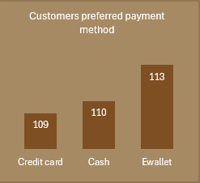
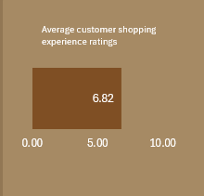
Insights from Mandalay (Branch B)
Sports and travel products sold more.
Male customers are more than the female.
E-wallet is the most preferred payment method.
Mandalay recorded the lowest average customer experience ratings.

Slide 9
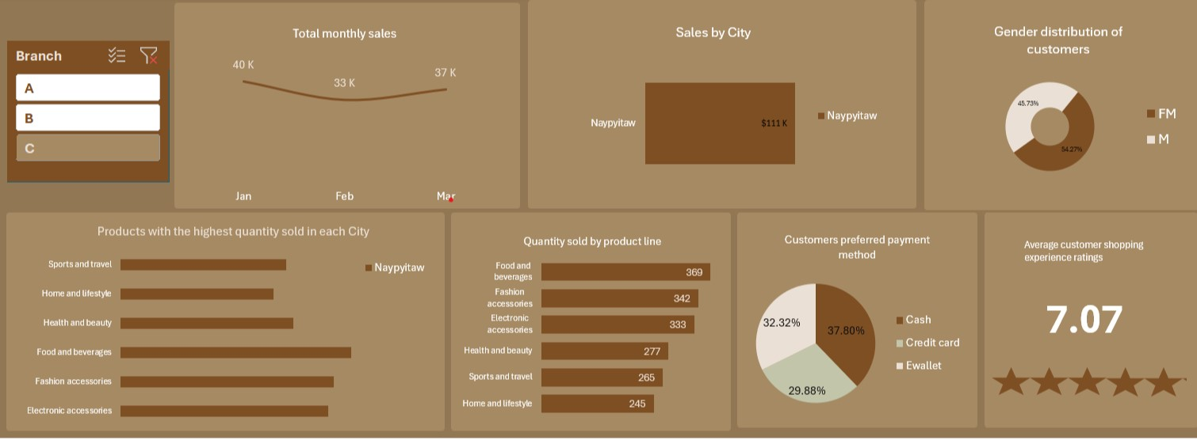
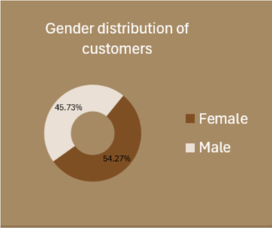
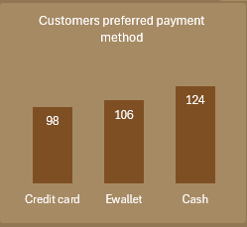
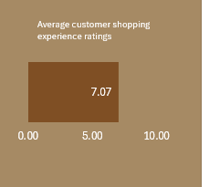
Insights from Naypyitaw (Branch C)
Food and beverages products sold more
Female customers are more than the male.
Cash is the most preferred payment method.
Average customer experience ratings.

Slide 10
Conclusions
High sales recorded in January could be a result of some discount programs by the company.
Overall top three selling products are electronic accessories, food and beverages, and sports and travel products, however, at different locations, the top three products differ.
Naypytaw high customer shopping experience ratings could be a factor that contributed to the high sales.
Mandalay recorded the lowest customer rating, even though it’s with a slight difference, it is important to further dig deeper into where the customer experience is lacking.
At Mandalay and Yangyon, E-wallet is the most preferred payment method. This is possibly because the shoppers are more of male.
Food and beverages selling more at Naypytaw with the payment method preferred being cash could be because the customers are mostly female.

Slide 11
Recommendations
At Yangyon, home and lifestyle products should never be out of stock. Also, the second and third most sold products, sports and travel, and electronic accessories should be closely watched.
At Naypyitaw, food and beverages should always be available for sale as it generated more sales. Also, it is important to have a plan towards securing cash as more customers at the branch prefer to pay with cash.
The average customer support ratings at Naypyitaw and Yangyon are good, however, there could be a need for staff trainings to increase the ratings. When customers experience good customer shopping experience, customers retainment level increases, generation of new customers is possible, which will translate to increased sales.
Special attention should be paid to training staff members at Mandalay.

Slide 12
Thank You

